Slide 1
PySortSearch Algorithms in Python - Logiya Vidhyapathi 30/05/2024

Slide 2
Aim of the Project
The aim of the project "PySortSearch: Algorithms in Python" is to provide a comprehensive toolkit for efficient data management, sorting, and searching operations in Python. This project focuses on implementing advanced algorithms and data structures tailored for organizing large datasets and optimizing search queries.
Efficient Sorting Algorithms
Optimized Searching Techniques
Flexible Data Structures
Comprehensive Documentation

Slide 3
Problem Statement
Inefficient Data Handling: Businesses face delays and increased costs due to inefficient data processing and retrieval.
Solution: Implement and compare fundamental sorting and searching algorithms to address data management challenges.
Data Management Efficiency: Offer multiple sorting algorithms for diverse data types and sizes.
Quick Data Retrieval: Binary and linear search algorithms enable fast data retrieval.
Resource Optimization: Compare execution times to identify the most efficient methods.
Scalability: Understand algorithm strengths for efficient scaling as business grows.
Educational Tool: Train employees on algorithm selection and performance optimization.
Outcome: Faster, more reliable data processing leading to improved decision-making and operational performance.

Slide 4
Project Description
This project focuses on implementing and comparing fundamental algorithms for sorting and searching, which are essential for efficient data management and retrieval in various business applications. The main goal is to provide a comprehensive understanding of how different algorithms work, their performance characteristics, and their appropriate use cases.
Algorithms Implemented:
Sorting Algorithms:
Bubble Sort
Insertion Sort
Selection Sort
Merge Sort
Quick Sort
Searching Algorithms:
Linear Search
Binary Search

Slide 5
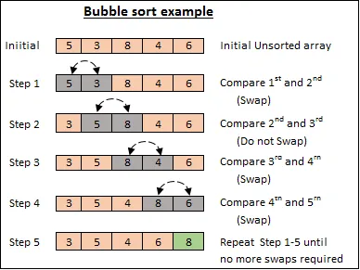
Bubble Sort
Bubble Sort is a simple comparison-based sorting algorithm that repeatedly steps through the list, compares adjacent elements, and swaps them if they are in the wrong order. This process is repeated until the list is sorted. Although simple and easy to understand, Bubble Sort is inefficient for large datasets due to its O(n^2) time complexity. It is best suited for small or nearly sorted lists.

Slide 6
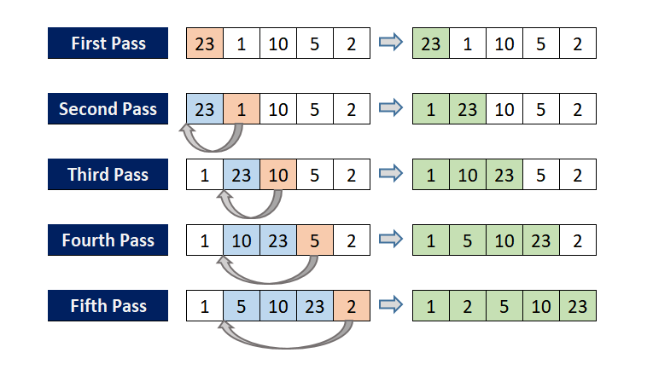
Insertion Sort
Insertion sort is a straightforward algorithm for sorting small datasets or nearly sorted lists. It works by iteratively building the final sorted list one element at a time. At each iteration, the algorithm takes the next element and inserts it into its correct position within the already sorted portion of the list. This process continues until all elements are sorted. While insertion sort may not be as fast as more advanced algorithms for large datasets, its effectiveness lies in its simplicity and suitability for small or partially sorted datasets.

Slide 7
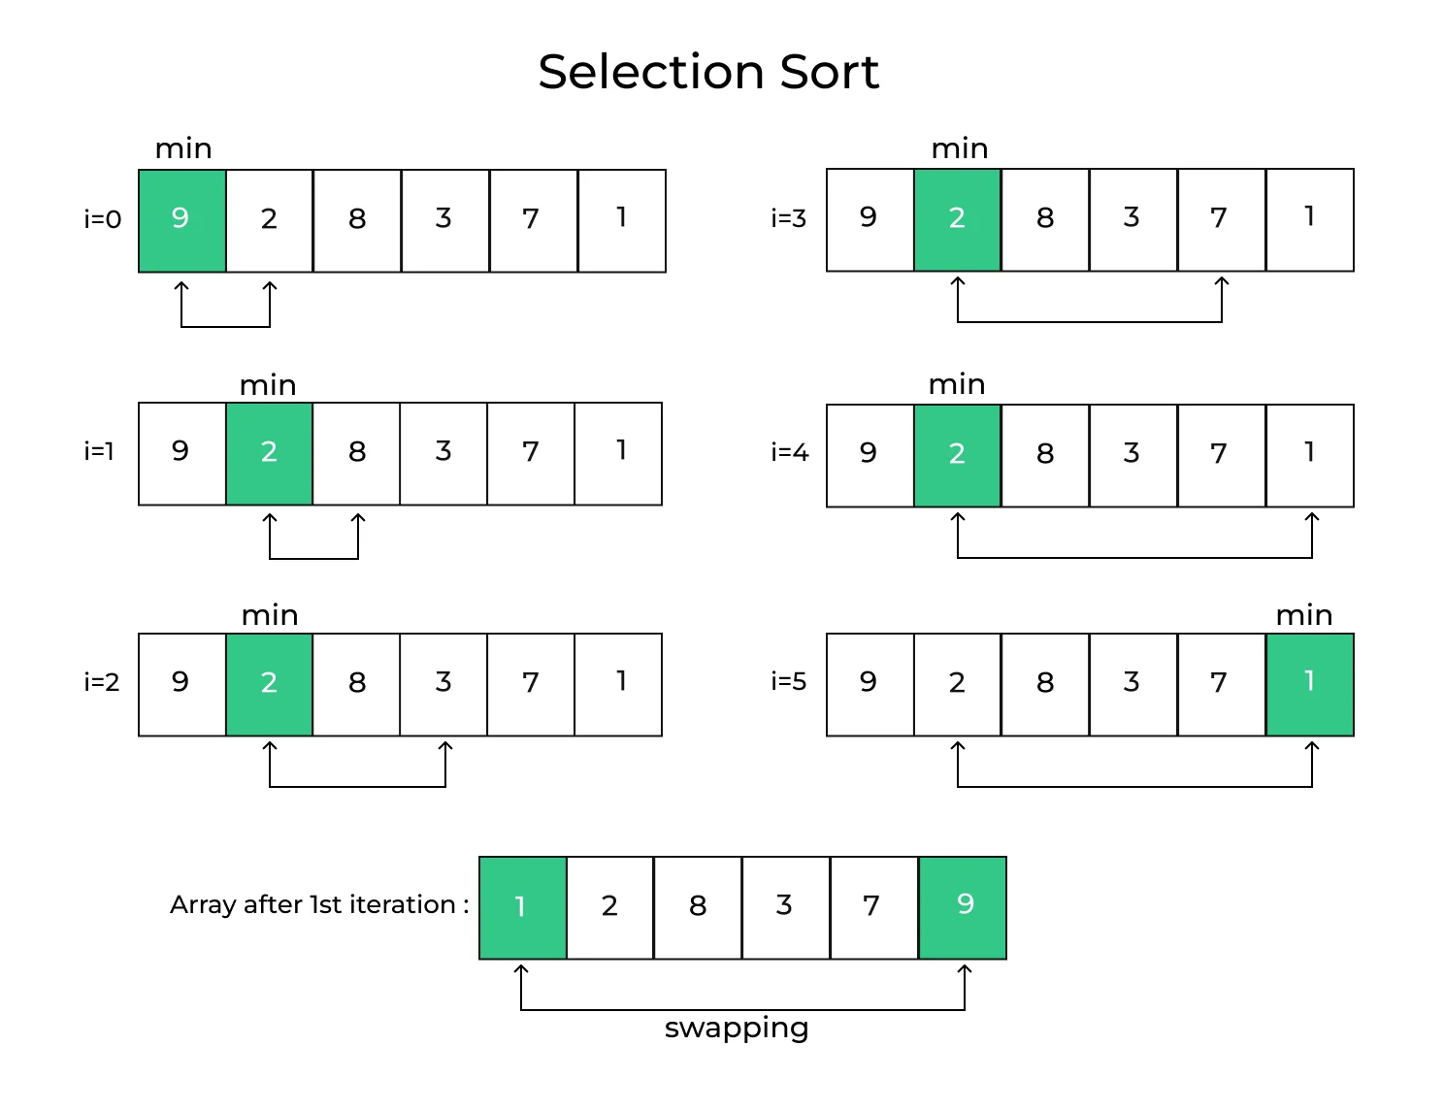
Selection Sort
Selection sort is an elementary sorting algorithm that divides the input list into a sorted and an unsorted region. It repeatedly selects the smallest (or largest) element from the unsorted region and swaps it with the first unsorted element, thereby expanding the sorted region. While selection sort is easy to implement and understand, its time complexity of O(n^2) makes it less efficient for large datasets.

Slide 8
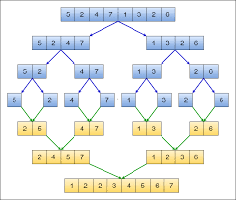
Merge Sort
Merge sort is a divide-and-conquer algorithm that recursively divides the input list into smaller sublists until each sublist contains only one element. It then merges these sublists back together in sorted order. Merge sort is known for its stable performance and consistent time complexity of O(n log n), making it suitable for sorting large datasets efficiently.

Slide 9
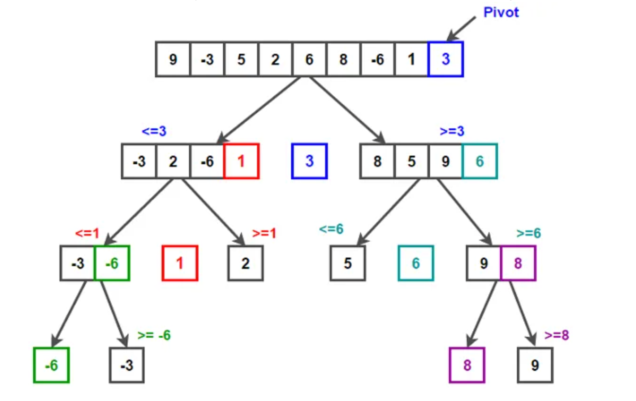
Quick Sort
Quick sort is another divide-and-conquer algorithm that selects a pivot element and partitions the input list into elements less than and greater than the pivot. It then recursively sorts these partitions. Quick sort is highly efficient for large datasets, particularly on average, with a time complexity of O(n log n). However, its performance may degrade in certain scenarios if the pivot selection is not optimized.

Slide 10
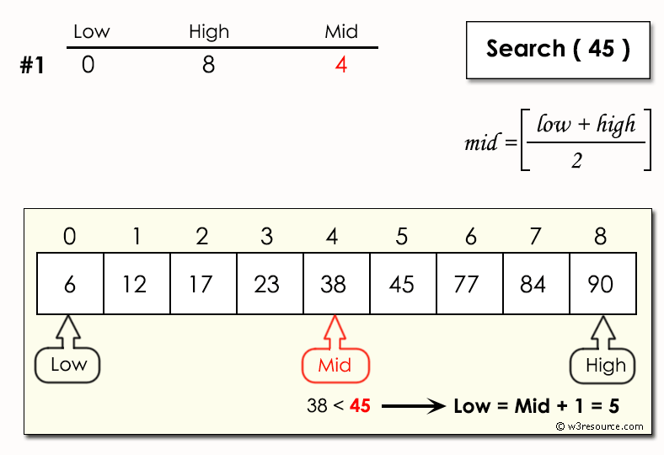
Binary Search
Binary search is a fast and efficient search algorithm used to find a target element within a sorted list. It works by repeatedly dividing the search interval in half until the target element is found or the search interval becomes empty. Binary search has a time complexity of O(log n), making it highly efficient for large sorted datasets

Slide 11
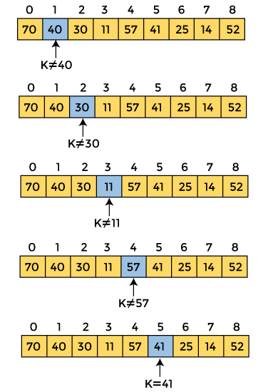
Linear Search
Linear search, also known as sequential search, is a simple search algorithm that checks each element in the list one by one until the target element is found or the end of the list is reached. Linear search is straightforward to implement and suitable for small or unsorted datasets. However, its time complexity of O(n) makes it less efficient compared to binary search for larger datasets.

Slide 12
Input Versatility with Error Handling and Exception Handling
Input Versatility:
Users can input lists of integers separated by spaces, accommodating different lengths and values.
Various sorting and searching algorithms are available for selection, providing flexibility to experiment.
Search operations require input of both the list and the target element, facilitating precise searches.
Error Handling:
Validates user inputs to ensure they are valid integers and correctly formatted lists.
Notifies users of invalid algorithm selections and prompts for valid choices.
Verifies if the input list is sorted before performing binary search, ensuring accurate results.
Exception Handling:
Manages value errors from invalid input values, prompting users to input correct data.
Handles key errors related to dictionary keys (not explicitly used), maintaining smooth execution.
Catches unforeseen errors during execution and provides user-friendly guidance on how to proceed or retry.

Slide 13
Algorithm Comparison Overview
Algorithm | Approach | Efficiency | Use Case | Result
Bubble Sort | Compares adjacent elements, swaps if needed | Inefficient (O(n^2)) | Small datasets; educational purposes | Outputs sorted array
Insertion Sort | Finds min/max and swaps with first element | Inefficient (O(n^2)) | Small datasets | Outputs sorted array
Selection Sort | Builds sorted array one element at a time | Efficient for small lists | Small or nearly sorted datasets | Outputs sorted array
Merge Sort | Divides array into halves, recursively sorts, then merges | Efficient (O(n log n)) | Large datasets; stability needed | Outputs sorted array
Quick Sort | Picks pivot, partitions, recursively sorts sub-arrays | Efficient (O(n log n)) | Large datasets; sensitive to pivot choice | Outputs sorted array
Linear Search | Divides sorted array in half, reduces search space | Efficient (O(n log n)) | Sorted lists; faster retrieval | Outputs index or not found message
Binary Search | Sequentially searches through entire list | Inefficient (O(n)) | Small lists; unsorted data | Outputs index or not found message

Slide 14
Conclusion
The implemented sorting and searching algorithms provide a valuable toolkit for data manipulation and retrieval tasks. Through this project, users can interactively select and execute these algorithms on their datasets, gaining insights into their performance and characteristics. The project demonstrates the efficiency and effectiveness of various algorithms, enabling users to make informed decisions when choosing the most suitable approach for their specific requirements.

Slide 15
Thank you

